Slide 1
Recommendation System

Slide 2
Group No-3 Members Ms. Dipali Vijay Roham Ms. Dhanashree Suresh Koli Mr. Dinesh Bharmu Bandivadekar Ms. Rutuja Jagdish Bansode Ms Sonia Shrikant Mondal Mr. Dipak Anil Wagh Mr.Tushar Naresh Mondkar Mentor-Raj

Slide 3
Business Objective
Data is scrapped from LinkedIn .Data is Provided related to Jobs title and industry domain . The objective is to understand the underlying structure in your dataset and come up with a suitable Recommendaton model which can be effectively recommend jobs location based on the Job profile. This recommendation model will be used by job seekers who are finding jobs based on the preference location .

Slide 4
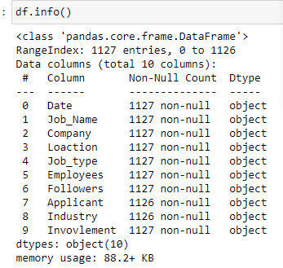
Dataset Details
Dataset contain 9 columns and 1127 rows.In which names as Jobs_Name,Company,Location,Job_Type,Employees,Followers,Applicant,industry,Invovlement.
There are 2 null values present so we remove the rows containing null values.

Slide 5
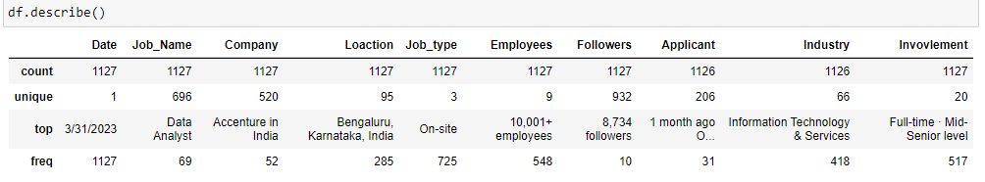
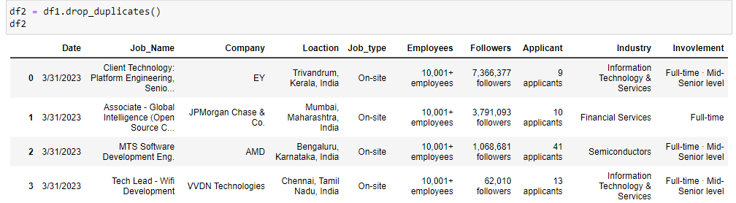
EDA 1 : Describe Dataset
There are 79 duplicate rows present

Slide 6
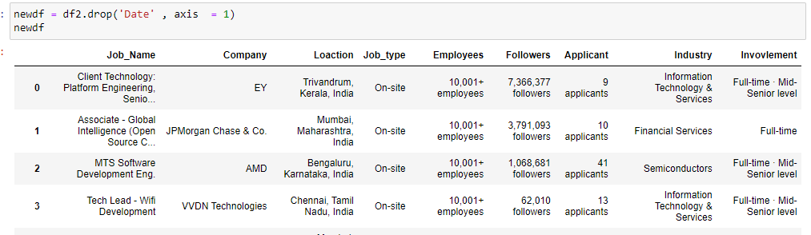
After removing the duplicated rows, there are 1048 rows are there.

Slide 7
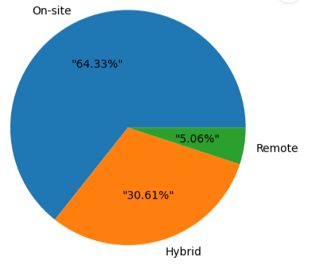
Pie Chart of Job type

Slide 8
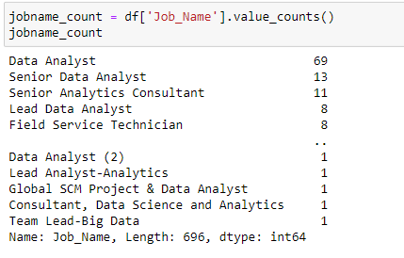
Count of Jobs Name

Slide 9
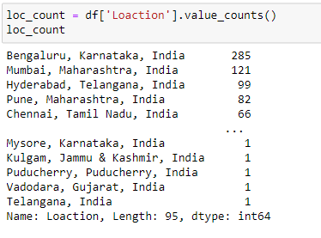
Jobs Locations

Slide 10
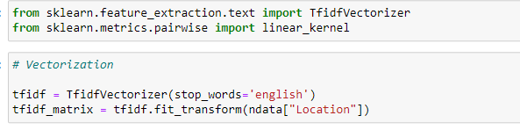
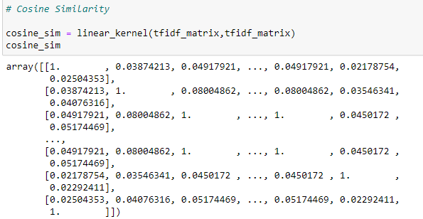
Recommendation based on location

Slide 11
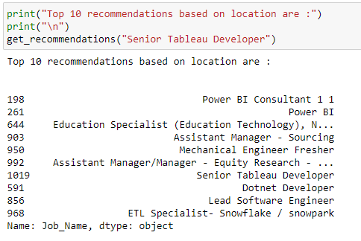

Slide 13
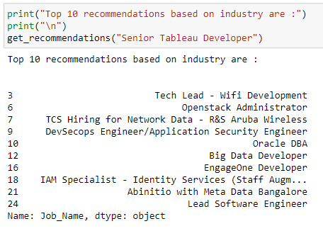
Recommendation based on Industry

Slide 14
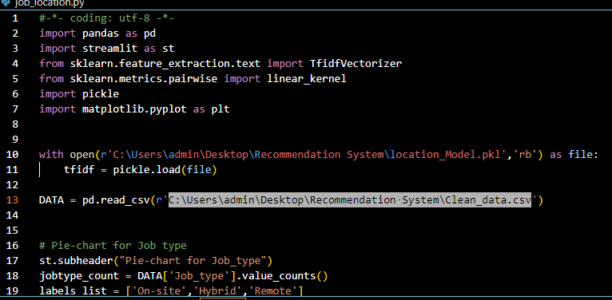
Model Deployement
Run the code in Visual Studio

Slide 15
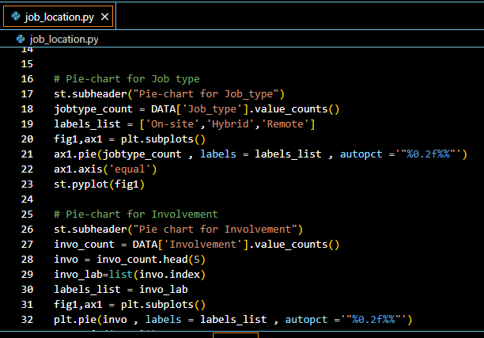
Pie Chart added in Streamlit

Slide 16
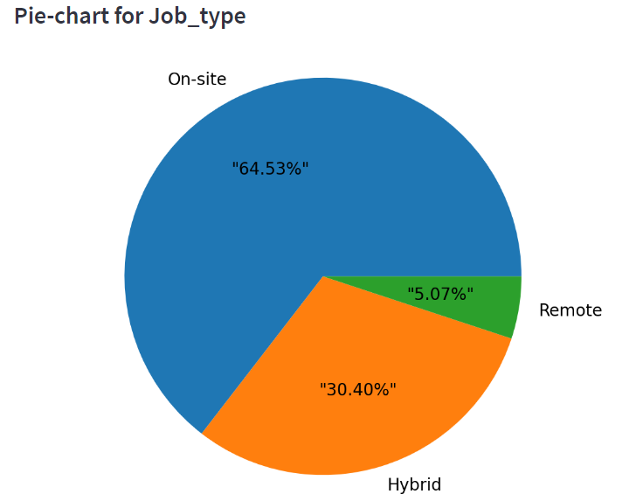
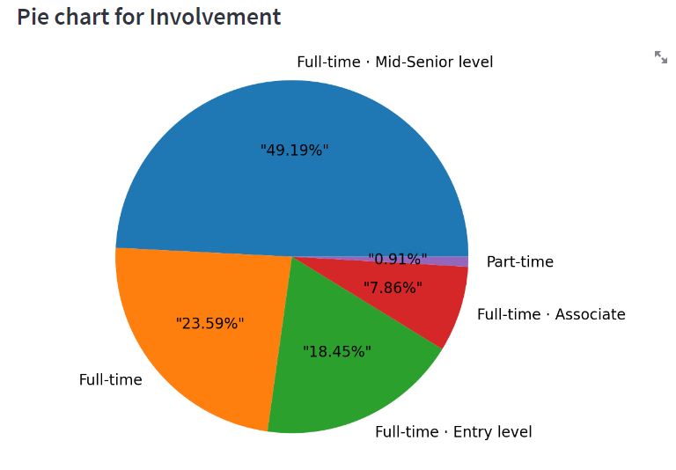
Job Type, Involvement, Industry, Company, Job Name, Location

Slide 17
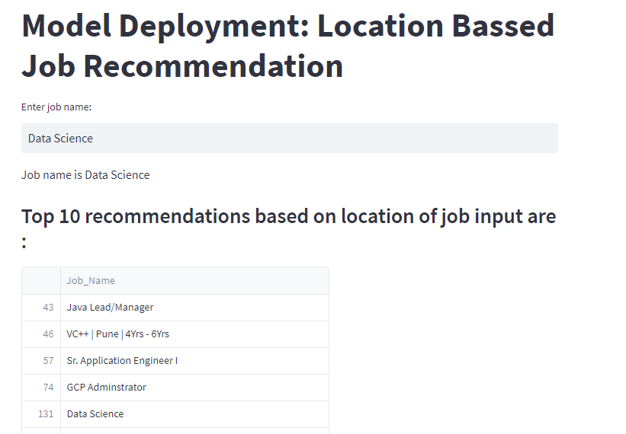
Final Deployement :Location Based Job Recommendation were we have added the pie chart

Slide 18
Challenges Faced
During the project we don’t have a dataset,firstly we have to find dataset were we have learn “How to scrab the data” using scrapping tools then we start the Data Cleaning,EDA ,Model Building and Deployement .

Slide 19
Thank You

